Slide 1
Prime Factorisation:
Building tree diagrams, explore index notation

Slide 2
Learning Intentions
Students will decompose numbers into prime factors.
They will understand that composite numbers are built up from prime factors.
They will model how to record index notation.
They will use critical and creative thinking to communicate solutions effectively
Proficiency strands
Understanding: Students represent composite numbers as a product of their prime factors.
Reasoning: Students classify factors as prime or composite, consider alternative factor trees for the same composite number.
Problem solving: Students explore how to efficiently record expressions with multiplication. Fluency: Students identify a factor as prime or composite

Slide 3
What’s the point of learning about prime and composite numbers?
12 is not a prime number because it will divide by 1,2,3,4,6 and 12. This means that if you have 12 eggs, there are several different shaped boxes you can neatly fit them all into.
13 is a prime number because it will only divide exactly by 1 or 13. If you have 13 eggs, the only box they will neatly fit into has one row of 13 eggs. If you try boxes that are shorter and wider, you'll never neatly fit all 13 eggs in.

Slide 4
Prime Numbers Hide Your Secrets
Every time someone makes a purchase online that involves a credit card, prime and composite numbers are involved in the transaction.
The computer uses a code to recognize a person’s credit card.
Before the buyer's credit card information is sent through cyberspace, it is encrypted to protect it from being stolen by a computer hacker.
To make sense of the encrypted information, a key to the code is required. One of the most popular methods of encryption makes use of prime and composite numbers.
Encryption codes can be created by banks by multiplying two prime numbers together.
When 2 prime numbers are multiplied together this results in a composite.
The composite number is recognized by the computer, but only the bank knows the two original prime numbers.
Because there are an unknown number of prime numbers, it is nearly impossible to break down the composite number into its two prime factors.
Without the two primes, a hacker can’t access the credit card information.

Slide 5
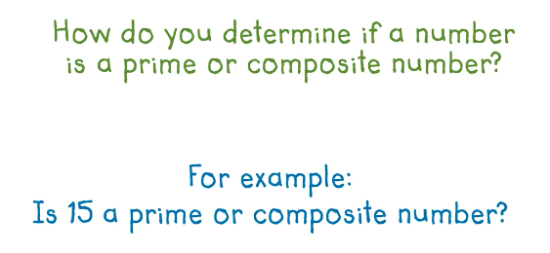

Slide 6
5
9

Slide 7
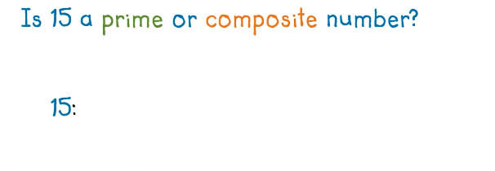

Slide 8
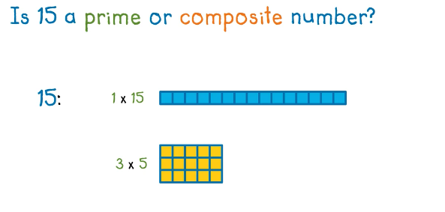
15 is a composite because it has more than two factors (1, 3, 5 and 15)

Slide 9
The prime numbers smaller than 100 are:
2, 3, 5, 7, 11, 13, 17, 19, 23, 29, 31, 37, 41, 43, 47, 53, 59, 61, 67, 71, 73, 79, 83, 89, 97 ...
...and they go on for ever. So far nobody has found a pattern to predict them and they can't decide if 1 is prime or not!

Slide 11
Maths Antics Prime factorization
Math Antics - Prime Factorization - YouTube

Slide 12
TASK:
How do we know 24 is a composite number?
Write 2 factors of this composite number. If it’s a prime, draw a square around it to show the branch is complete.
Continue until all factors have a square around the number.
24
Break into factors
2
12
2
6
Keep going until all the factors are prime
2
3
2 x 2 x 2 x 3
Notes:
24 has the factors

Slide 13
24
Break into factors
6
4
Keep going until all the factors are prime
2
3
2
2
2 x 3 x 2 x 2

Slide 14
24
8
3
2
4
= 3 x 2 x 2 x 2
Record a multiplication expression using prime factors and index notation for each of your expressions.
2
2
$${= 2}^{3}x 3$$

Slide 15
So, all of the prime factor for 24 are: 2 x 2 x 2 x 3
If we multiply all possible combinations of the prime numbers for 24, we can work out all of the factors for 24
We already know 1 and 24 are factors
2 x 2 = 4
2 x 2 x 2 = 8
2 x 2 x 3 = 12
2 x 2 x 2 x 3 = 24
2 x 3 = 6
All factors of 24 = 1, 2, 3, 4, 6, 8, 12, 24

Slide 16
10
20
28
2
5
2
14
2
10
2
7
Prime factors: 2 X 5
All factors: 1, 2, 5, 10
2
5
Prime factors: 2 X 2 X 7
All factors: 1, 2, 4, 14, 28
Prime factors: 2 X 2 X 5
All factors: 1, 2, 4, 5, 10
2 x 2 = 4 2 x 2 x 5 = 20
2 x 5 = 10
2 x 2 = 4 2 x 2 x 7 = 28
2 x 7 = 14

Slide 17
Your Turn
Slightly Harder
Easy
30
Draw a factor tree for each of the following numbers to find out their prime factors
Then multiply the prime factors to work out all of the composite factors
Record all factors in ascending order
10
56
20
81
28
72

Slide 18
Your Turn B
45
24
84
120
Prime Factors:
… x …. x ….. x … x….
Prime Factors:
… x …. x ….. x … x….
Prime Factors:
… x …. x ….. x … x….
All Factors ascending order:
1, ..., …., …, …., …, ….
All Factors ascending order:
1, ..., …., …, …., …, ….
All Factors ascending order:
1, ..., …., …, …., …, ….

Slide 19
Your Turn C
28
54
108
140
Prime Factors:
… x …. x ….. x … x….
Prime Factors:
… x …. x ….. x … x….
Prime Factors:
… x …. x ….. x … x….
All Factors ascending order:
1, ..., …., …, …., …, ….
All Factors ascending order:
1, ..., …., …, …., …, ….
All Factors ascending order:
1, ..., …., …, …., …, ….

Slide 20
Your Turn D
70
210
132
300
Prime Factors:
… x …. x ….. x … x….
Prime Factors:
… x …. x ….. x … x….
Prime Factors:
… x …. x ….. x … x….
All Factors ascending order:
1, ..., …., …, …., …, ….
All Factors ascending order:
1, ..., …., …, …., …, ….
All Factors ascending order:
1, ..., …., …, …., …, ….

Slide 21
Your Turn: Sheet 1
56
30
32
99
16
55
144
Prime Factors:
… x …. x ….. x … x….
Prime Factors:
… x …. x ….. x … x….
Prime Factors:
… x …. x ….. x … x….
All possible factor combination pairs:
- -
- -
- -
All possible factor combination pairs:
- -
- -
- -
All possible factor combination pairs:
- -
- -
- -
All Factors ascending order:
1, ..., …., …, …., …, ….
All Factors ascending order:
1, ..., …., …, …., …, ….
All Factors ascending order:
1, ..., …., …, …., …, ….

Slide 22
Sheet 2
56
16
55
144

Slide 23
Extension

Slide 24
Factor trees
create your own factor trees for numbers rolled by two 10 sided dice, 1 dice for each of the 2 digits
roll and record the product by using 1 digit as the tens and 1 as the ones
create all factor trees for the number.
Record multiplication expressions that show composite numbers as products of their prime factors.
‘What do you think a prime factor is?’

Slide 25
Cutting squares
Your teacher wants to cut some squares of fabric and wants to minimise waste.
The fabric measures 420 cm x 378 cm.
Discuss strategies with a partner.
What can you draw to help you?
What is the largest square that can be cut?

Slide 26
The "24" Mystery!
If you square ANY prime number bigger than 3, then subtract 1, the answer always divides by 24!
E.g. 11² = 121 then 121 - 1 = 120 and yes 120 does divide by 24.
Record more examples to prove this ‘24’ mystery:
Investigate / Prove:
If you understand algebra, then you'll know that all prime numbers can be written as (6n+1) or (6n-1).
(6n+1)² = 36n²+12n+1. So (6n+1)² -1 = 36n²+12n. This factorises to 12n(3n+1). Either n or (3n+1) must be even, therefore the whole expression must be divisible by 24.

Slide 27
Index Notations
24
Break into factors
2
12
6
Keep going until all the factors are prime
2
2
Record a multiplication expression using prime factors and index notation for each of your expressions.
3
2 x 2 x 2 x 3
$$2^{3}x 3$$

